Slide 1
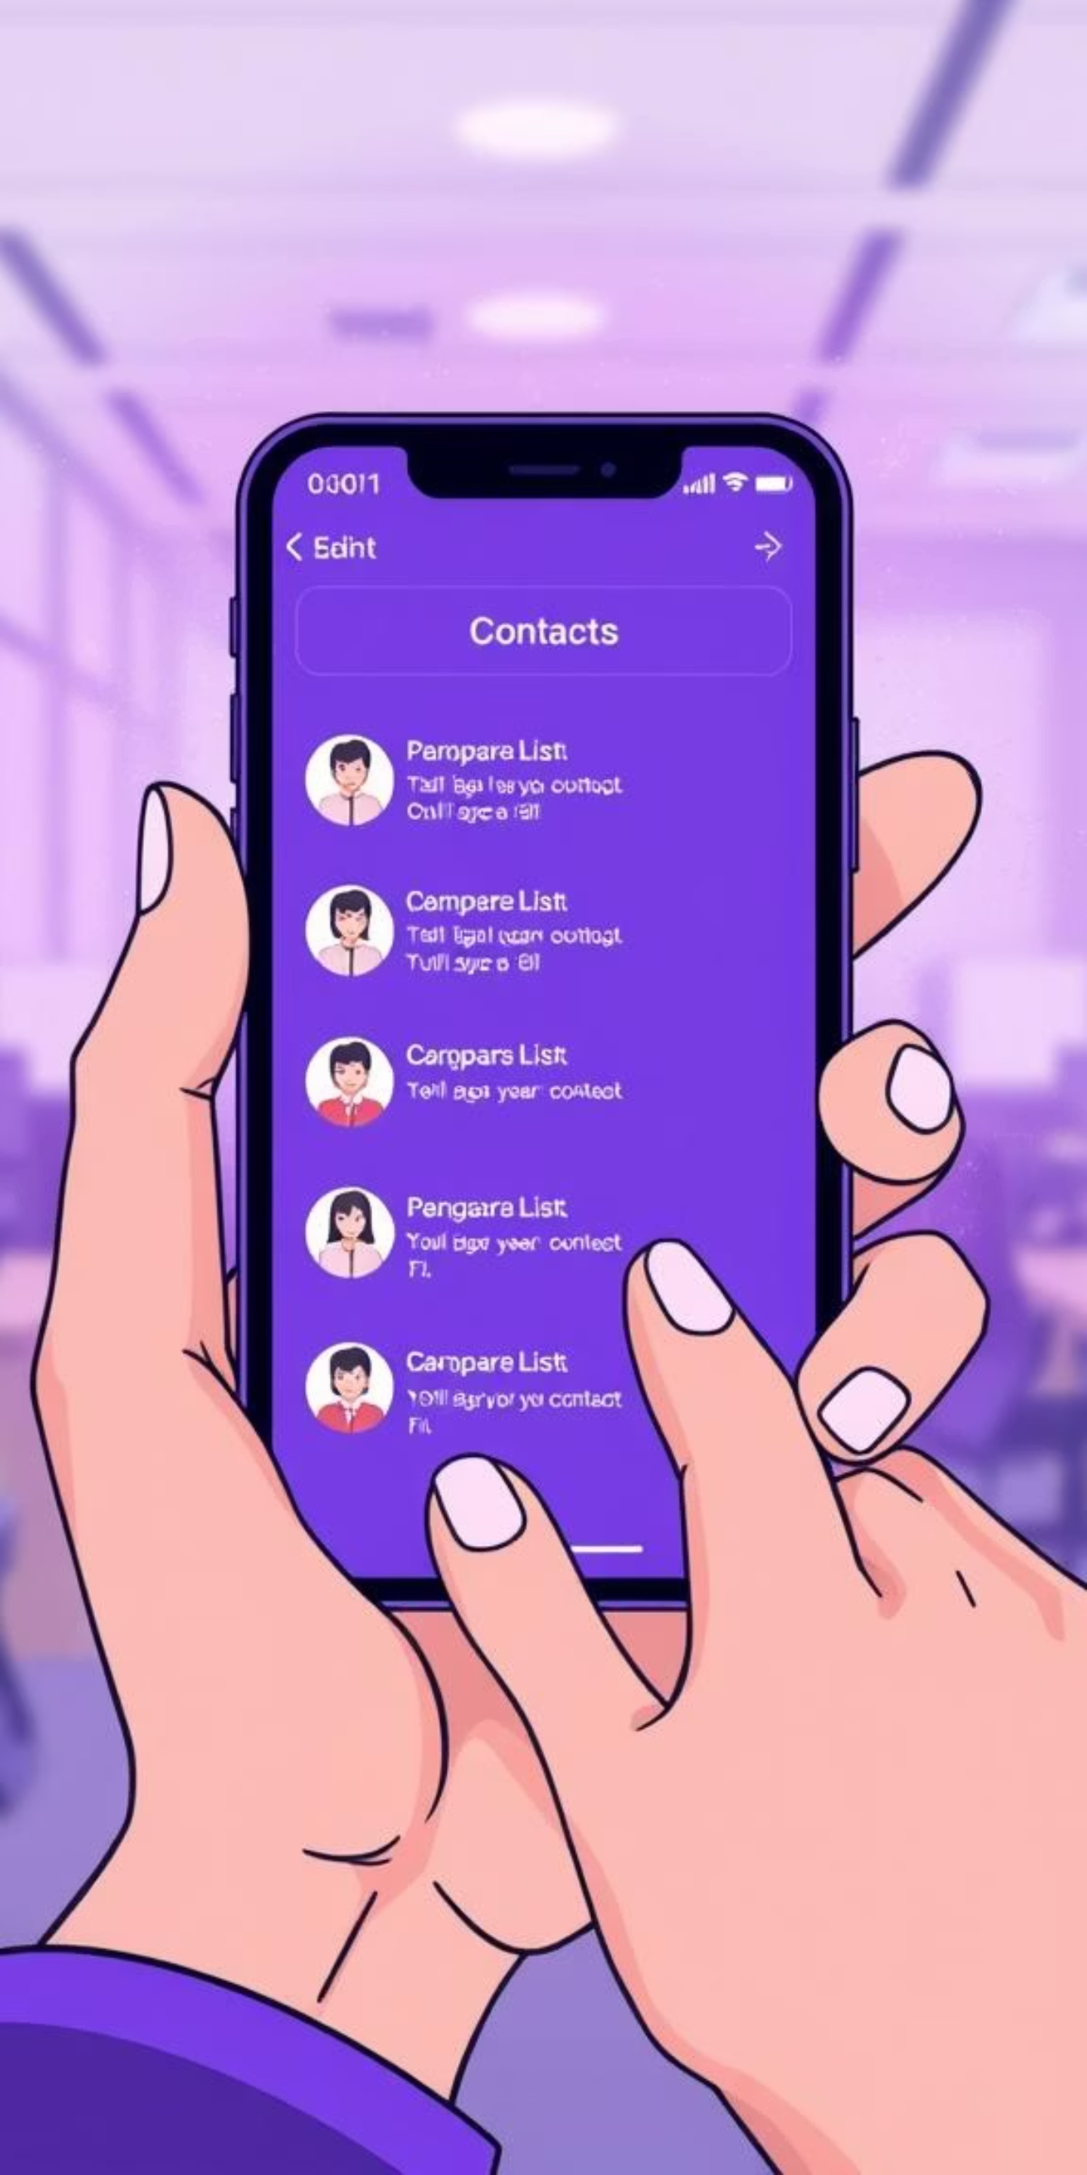
Smart Contact Manager - Major Project
A web-based contact management system built with Spring Boot.
Helps users store, organize, and manage personal & professional contacts securely.
Includes OTP authentication and CSF/vCard import/export for real-world usability.
HARSH SOLANKI (EN22CS301394)
SOURABH SANKHLA(EN22CS3L1022)
HARSH PATIDAR (EN22CS301392)

Slide 2

Problem Statement
People handle hundreds of contacts across devices and platforms.
In the digital era, individuals and organizations manage hundreds of personal and professional contacts.Existing solutions like phone contact lists or online services often face limitations such as:
Limited customization
Weak security for sensitive data
Difficulty in migrating or backing up contacts
No OTP-based authentication
Need: A secure, flexible, and portable contact manager.

Slide 3
Objectives
Centralize and simplify contact management.
Enable secure user authentication with OTP.
Support CRUD operations for contacts.
Import/export contacts using CSF or vCard (.vcf).
Ensure responsive design across devices.

Slide 4

Technologies Used
Backend:
Spring Boot (Java)
Frontend:
Thymeleaf, HTML, CSS, JavaScript
Database:
MySQL (Spring Data JPA)
Security:
Spring Security with OTP authentication
Data handling:
CSF file parsing, vCard (.vcf) support
Tools:
Maven, Hibernate Validator, DevTools

Slide 5







Features
OTP-based secure login
Add, edit, search, delete contacts
Import/export contacts (CSF & vCard)
Search & sort by name, phone, or email
Profile image upload
Email Integration & pagination
Responsive design (desktop + mobile)

Slide 6

Literature Review
IJRPR (2025): Smart Contact Manager with cloud & email automation.
IJRASET (2024): Scalability and modularity in Spring Boot contact systems.
IJEIT (2014): Human memory & contact tools.
ResearchGate (2012): Intelligent social contact management systems.

Slide 7
Conclusion & References
Conclusion:
Smart Contact Manager is a secure, efficient solution bridging academic learning with real-world needs.
Key highlights: OTP login, CSF/vCard portability, email automation.
References:
IJRPR (2025) – Smart Contact Manager research
IJRASET (2024) – Spring Boot integration
IJEIT (2014) – Human Memory & Contact Management
ResearchGate (2012) – Intelligent Social Contact Tools

